Slide 1
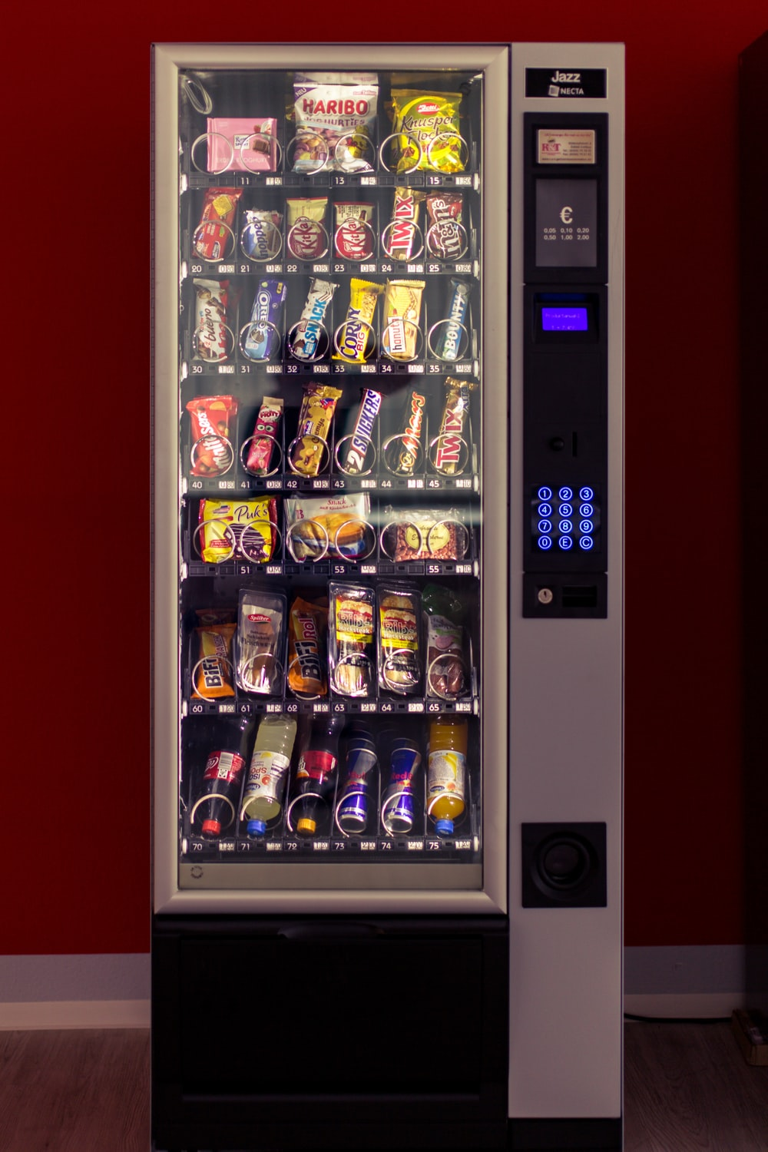

Customer Recommendation
Mohamad Figor Santoso

Slide 2
Outline
Business understanding
Data Understanding
Data preprocesing
Data Analysis
Obstacles

Slide 3
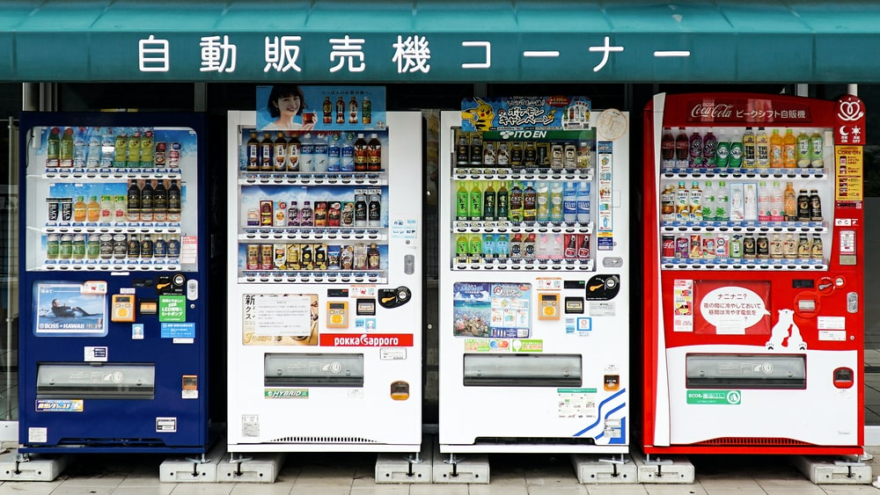
Business Understanding

Slide 4


Business Objective
Model Objective
“Customers will be offered a new product, vending machines, by the corporation”
“Create a classification model to identify whether a customer is good or bad if a new product is provided to him. A "1" flag indicates good, whereas a "0" flag indicates bad”

Slide 5
Data Understanding

Slide 6















Data Description
Customer ID
Age
City
Gender
Education
“Customer Id”
“Customer age (17 to 96 years old)”
Assumption: I only consider with age 17-96 (Age of student or active worker/entrepeneur)
“Customer residen”
“Customer gender”
“Customer education”
Job Status
Person Responsible
Business
Product
Family
“Is it possible that the consumer already has goods 1 through 6?”
“Customer status”
“Customer job”
“Customer guarantor”
“Customer business”
Type of Business
Turnover
Revenue
The Average Amount of Money Left
The Last Remaining Money
“Type of customer business”
“How quickly the customer's business operates”
“Income generated by the customer's business”
“Weekly average of remaining funds in the previous 1 to 6 months”
“Last money owed to the consumerin the previous 1 to 6 months ”

Slide 7







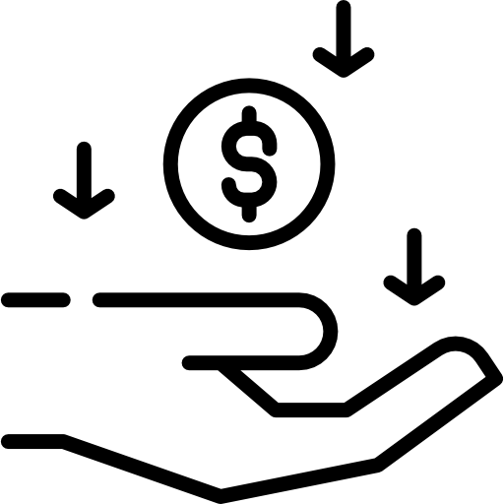


....
Hold Amount
Money on Hand
Remaining Debt
Debt Payment
The Total of Expenditure
“Money held by ccustomers”
“Money from customers is still available”
“The customer's remaining debt”
“Customer's debt payment amount”
“Customer expenditure”
The Total of Income
Frequency of Expenditure
Frequency of Income
Date
Flag
“Customer income”
“Frequency of customer expenditure”
“Date of data”
“A "1" flag indicates good, whereas a "0" flag indicates bad”
“Frequency of customer income”

Slide 8


Exploratory Data Analysis
Average of Age
34.7 years old
60%
40%
“Some customers are between the ages of 0 and -3, but they work”
from total population of data
11059

Slide 9
Data Preprocesing

Slide 10
71 features
Drop Misleading Data & Missing Value Handling
Feature transformation & Feature Selection
Modeling & Evaluation
Resampling Data

Slide 11
Modeling

Slide 12


“You should not focus at the accuracy of the modeling results when evaluating imbalanced data because the accuracy findings will be biased. should use F1-score or G-mean when deciding on the appropriate model”
“The Geometric Mean (G-mean) is a metric that measures the balance between classification performance on both the majority and minority classes”
“The F-measure is a popular metric for unbalanced classification.”

Slide 13
Model | Precision | Recall | F1-score | G-mean
Logistic Regression Default | 0.11 | 0.67 | 0.20 | 0.65
Logistic Regression Optimization | 0.11 | 0.67 | 0.20 | 0.65
Decision Tree Default | 0.12 | 0.61 | 0.20 | 0.58
Decision Tree Optimization | 0.13 | 0.65 | 0.22 | 0.58
Random Forest Default | 0.13 | 0.67 | 0.22 | 0.60
Random Forest Optimization | 0.12 | 0.73 | 0.21 | 0.68
AdaBoost Classifier Default | 0.12 | 0.75 | 0.21 | 0.70
AdaBoost Classifier Optimization | 0.12 | 0.79 | 0.21 | 0.74
XGBoost Classifier Default | 0.12 | 0.59 | 0.20 | 0.55
XGBoost Classifier Optimization | 0.12 | 0.70 | 0.21 | 0.65
SVM Default | 0.11 | 0.89 | 0.19 | 0.89
SVM Optimization | 0.13 | 0.47 | 0.21 | 0.42

Slide 14
Obstacle

Slide 15
Some challanges I face
Imbalance data in training set.
Data Misleading because human error or bad survey result.

Slide 16
Thank You

